Slide 1




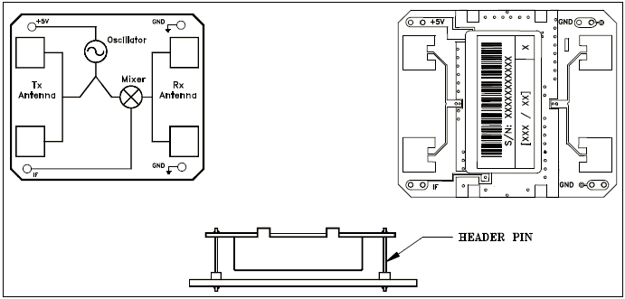
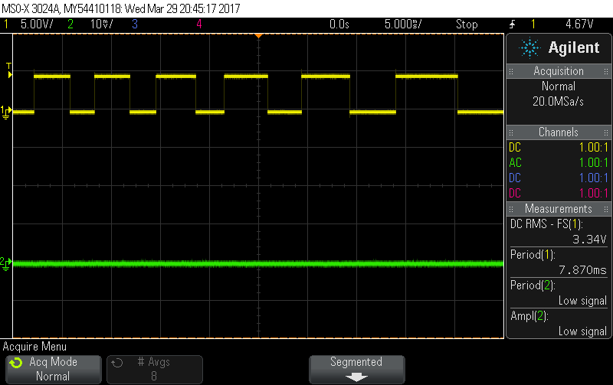
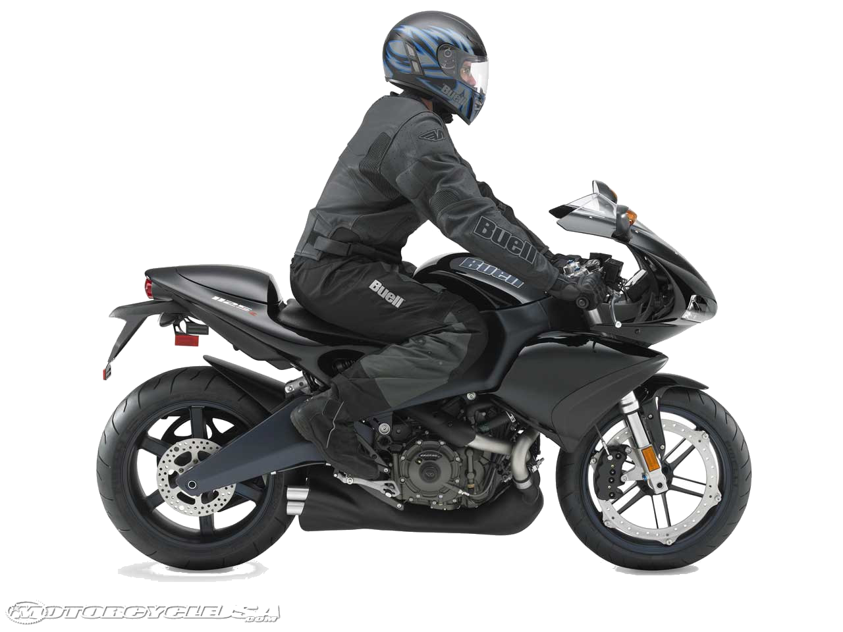

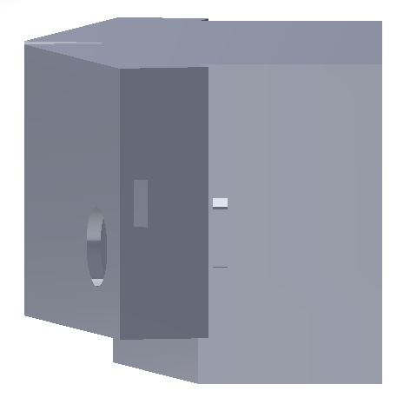
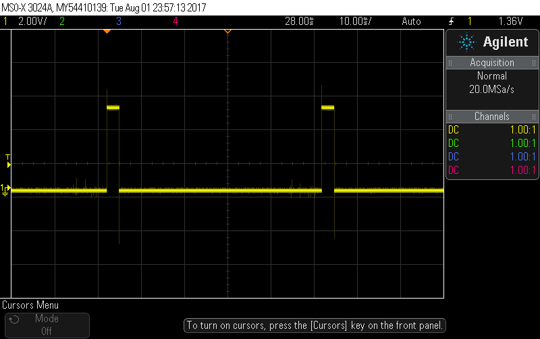
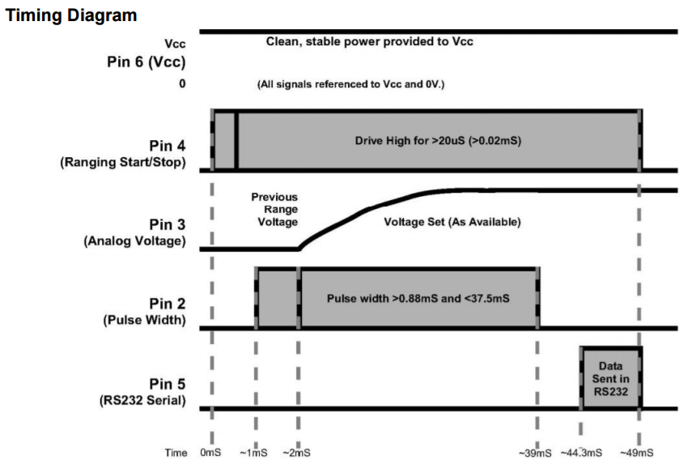
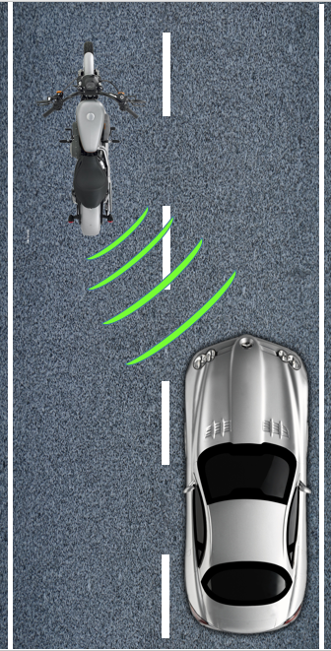
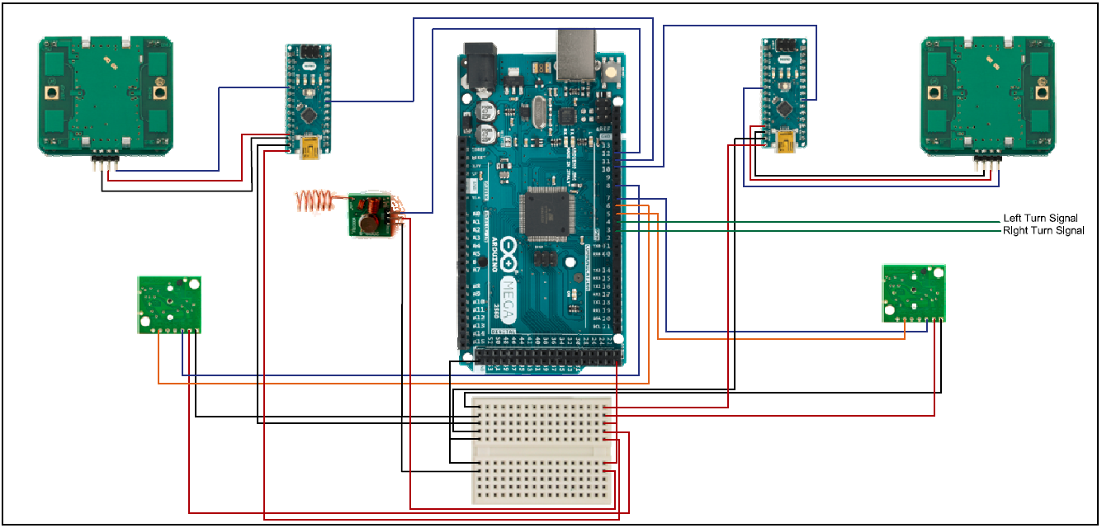
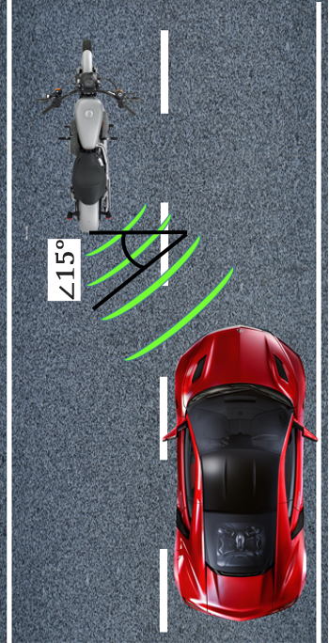
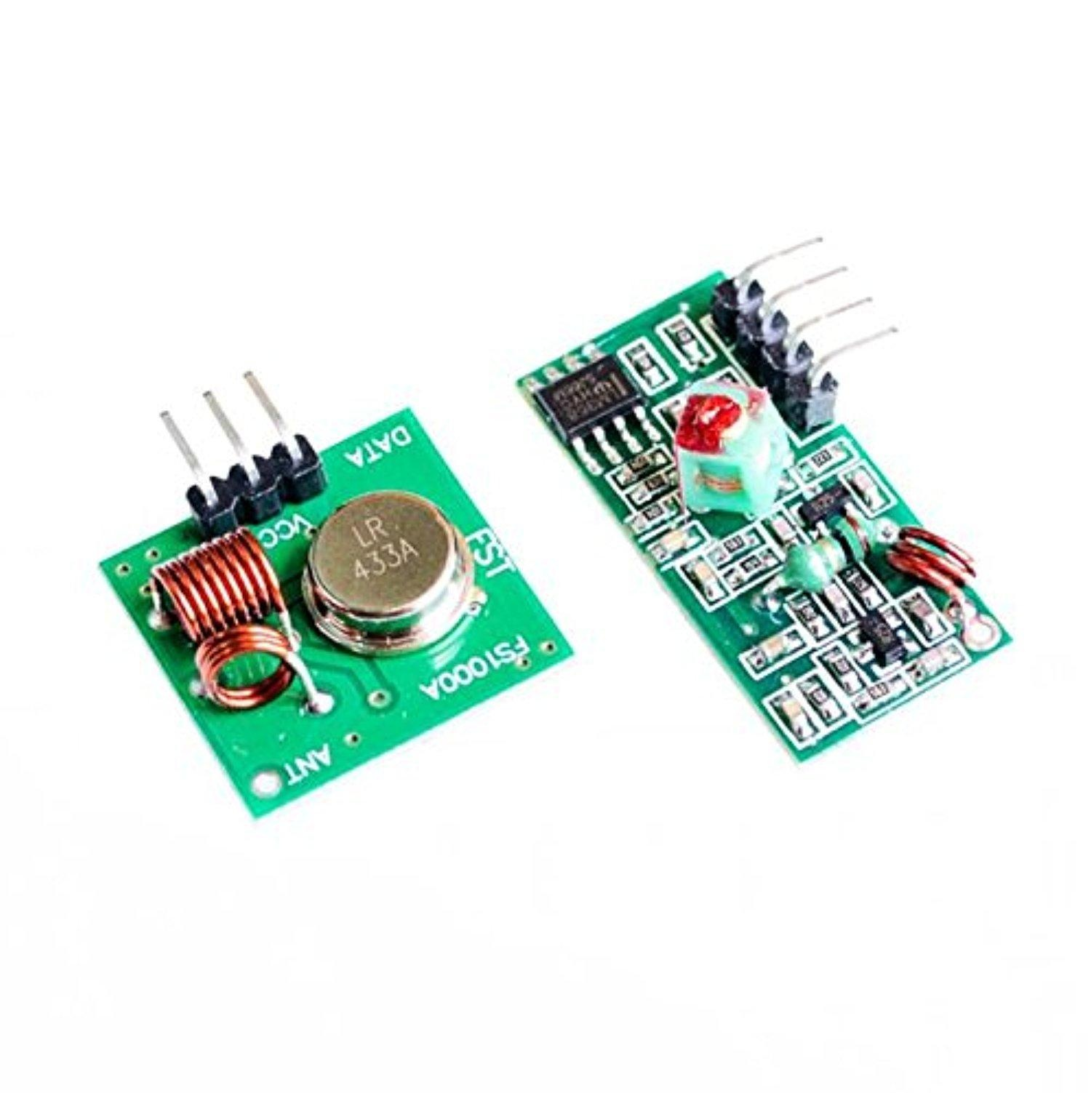
Wireless Blind Spot Detection for Motorcycles
Professor Joseph Santacroce
Wentworth Institute of Technology, Electrical Engineering Department
John Westerhof
BSEE ‘17
Kevin Dunnells
BSEE ‘17
Matthew Fitch
BSEE ‘17
The Problem
Motorcycle accidents account for 15% of all traffic deaths; 60% of which, were multi-vehicle accidents. This a is a staggering number considering only 2% of vehicles are motorcycles. When traveling at speeds of 70 mph a motorcyclist, when merging, who looks in their blind spot for 2 seconds travels 200 ft in that time.
Solution
To assist motorcyclists and improve their safety, we designed a blind spot detection system which can be mounted on the driver’s motorcycle and helmet. Upon turn signal activation the subsystems will work in tandem to instantaneously sense if there is an object in the motorcycle’s blind spot. If a detection is made the system will alert the driver via wireless LEDs implanted in the helmet.
Overview of Detection Methods:
Radar Module:
Sonar Module:
Transmit and Receive Module:
Design
The enclosure was designed to be installed on the back of a motorcycle while the receiver and warning system is integrated into the operator’s helmet.
Data/Observations
Radar Radar Effective Range: 10m Radar Positive Detection Speed: 7-35 MPH
The radar module consists of an HB100 microwave transceiver operating at 10.525Ghz. At 5V the sensor has an operational range of 10m.
Helmet Enclosure
Sensor Enclosure
Sonar Sonar Effective Range:: 6.5m Sonar Positive Detection Distance: 4m
The Sonar Module consists of a MaxSonar MB1010 ultrasonic module operating at 42Khz. The sensors optimal operating range is 7m.
Schematic
References:
1) Chilson, Luke. “The Difference Between ABS and PLA for 3D Printing.” ProtoParadigm. ProtoParadigm LLC. , 26 Jan. 2013. Web. 29 Mar. 2017
2) Wolff, Christian. "Radar Basics." Radar Basics. Christian Wolff, n.d. Web. 10 Apr. 2017.
3) Limpkin. "Limpkin's Blog." Making the Electronics for a $7 USD Doppler Motion Sensor. N.p., 09 Aug. 2013. Web. 10 Apr. 2017.
4) “Understanding the Science Behind the Ultrasonic Sensor.” ArduinoInfo. Tangient LLC. , n.d. Web. 17 Feb. 2017
The transmitter and receiver consist of an XY-MK-5V and XY-FST pair running at 433Mhz.
Sensor Orientation

